Slide 1
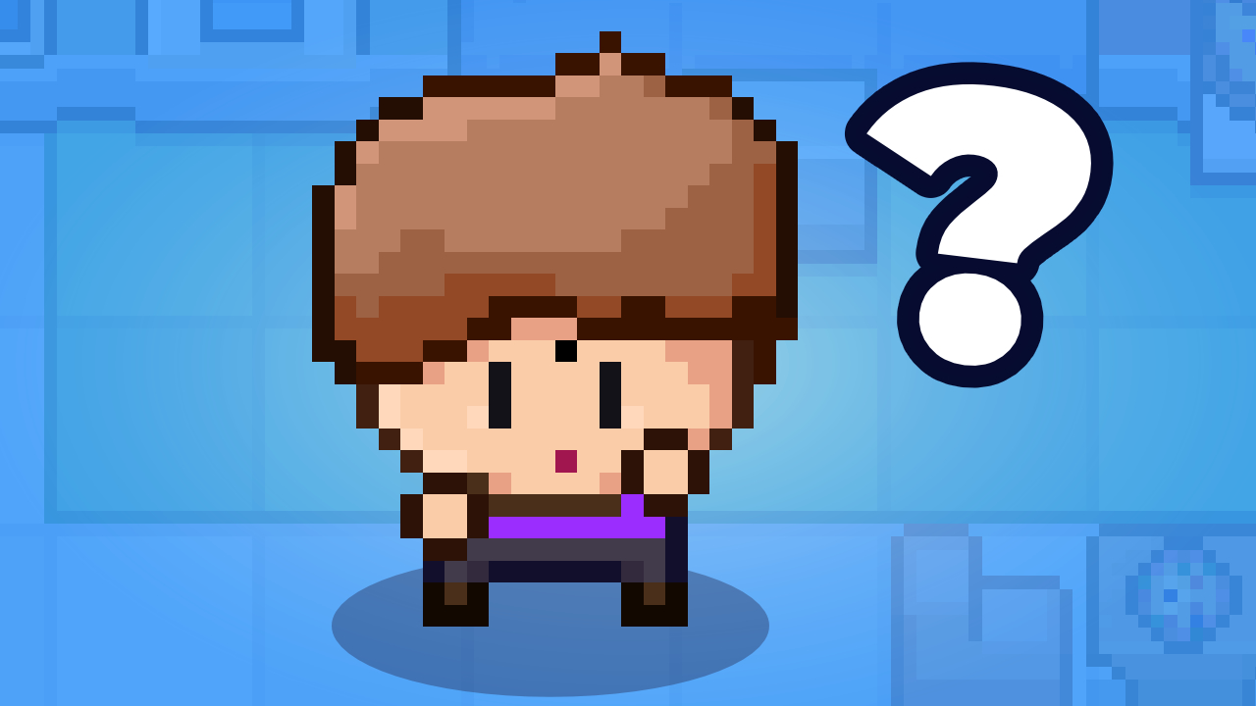
GAME DEV

Slide 2

GAME DEV

Slide 3

GAME DEV
CODING + FUN + DESIGN
Video game development is the process of developing a video game.
The effort is undertaken by a developer, ranging from a single person to an international team dispersed across the globe.
Development of traditional commercial PC and console games is normally funded by a publisher and can take several years to reach completion.
Indie games usually take less time and money and can be produced by individuals and smaller developers.

Slide 4

GAME DEV
Development team :
Designer
Artist
Programmer
Physics ,AI ,Sound ,Gameplay ,Scripting ,UI ,Input processing ,Network ,communications ,Game tools ,Level designer,Sound engineer
Tester

Slide 5
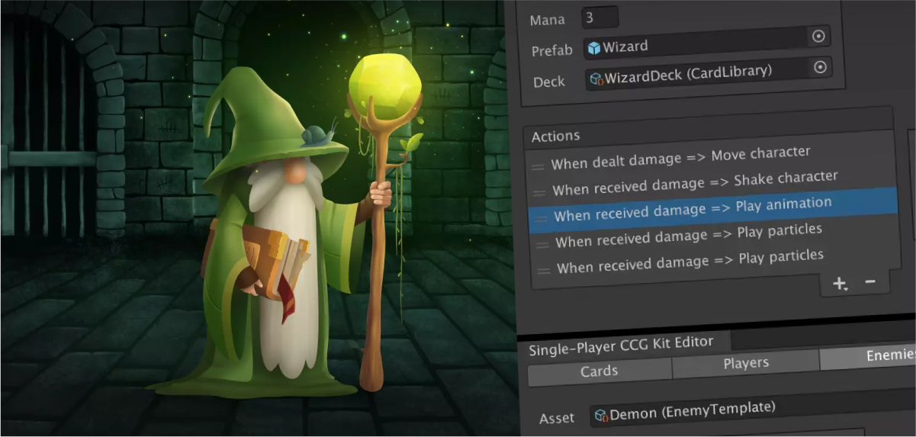
GAME DEV

Slide 6
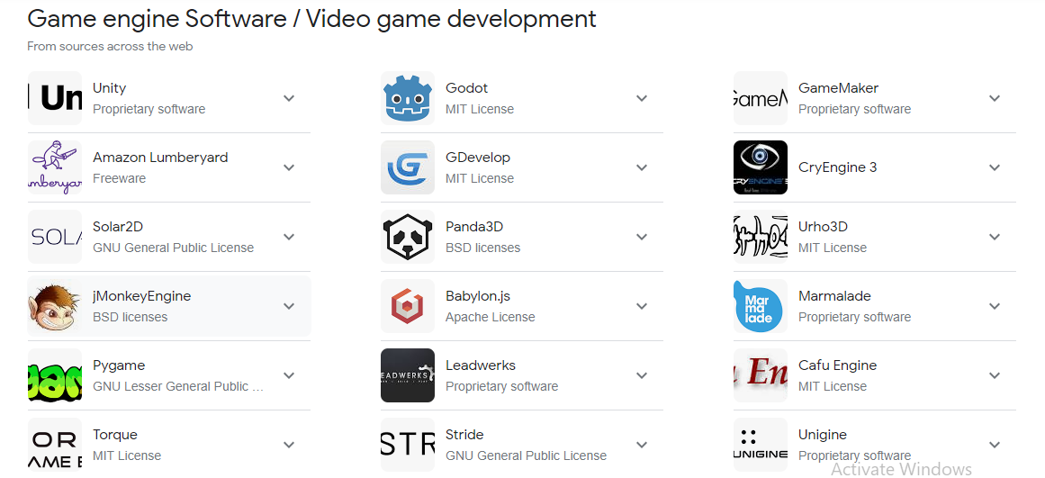
GAME DEV

Slide 7
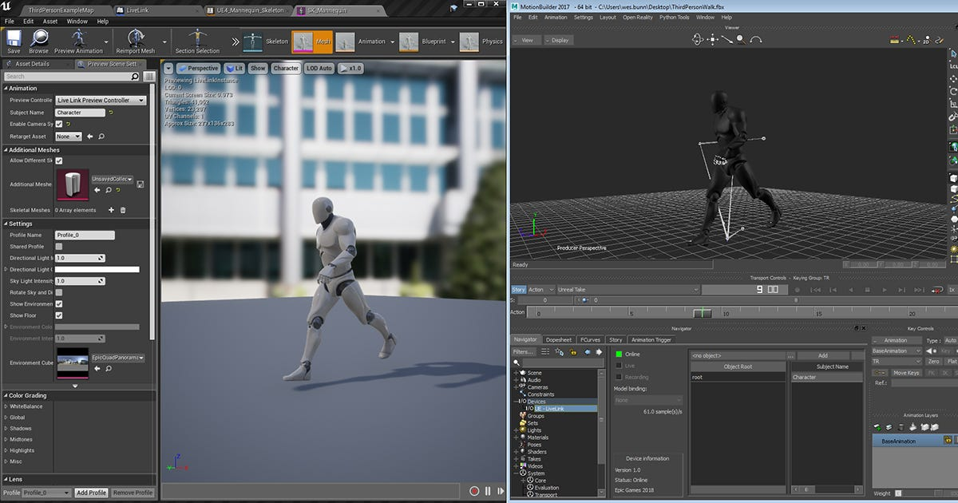

Slide 8
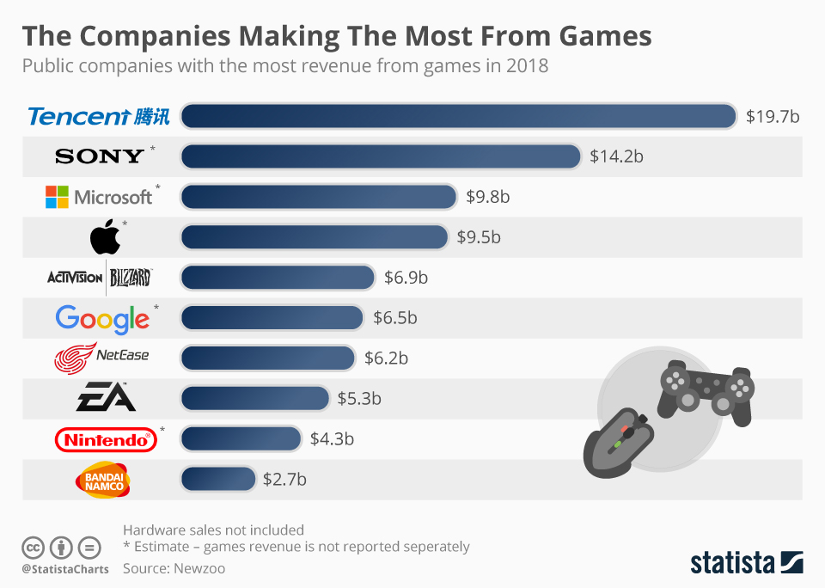

Slide 9
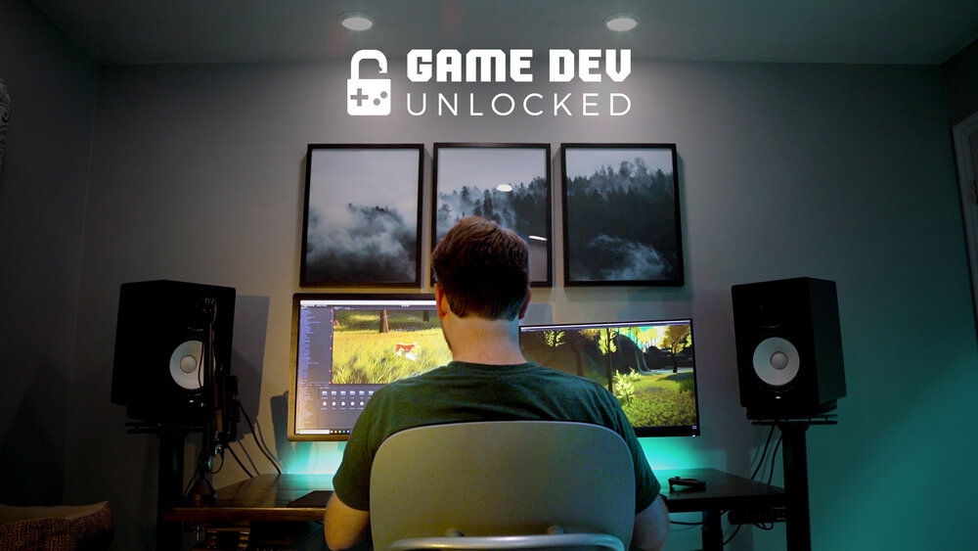
GAME DEV

